Slide 1
2094 Week 6 Tutorial
Floor Company Exercise
We will think about and practice convergent and divergent thinking for creativity and innovation

Slide 2
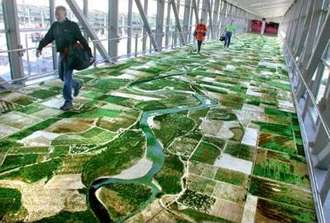
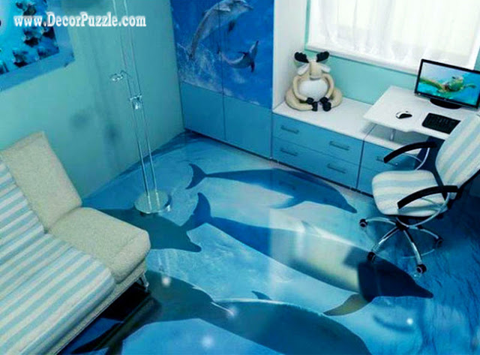
Floor Company Exercise
You are the new product development team for: Boring, Drab and Awful Floor Company
Your job is to develop 100 new floor covering, product ideas
  Avoid just adding an adjective like “soft” or “blue”
Use the creativity tool
Have fun and create energy!
10 minutes

Slide 3
A Creativity Tool
Try To
Slide It
Dissolve it
Compress it
Roll it
Stir it
Shake it
Spread it
Squeeze it
Separate it
Blend it
Slice it
Melt it
Decrease it
Increase it
Stack it
Inflate it
Divide it
Pry it
Clamp it
Make it
Transparent
Movable
Immovable
Sticky
Flexible
Inflexible
Spin
Bounce
Rotate
Remove
Hot
Cold
Slippery
Stretch
Pop up
Fly
Flicker
Foamy
Explode
Add or Subtract
Springs
Elastic
Cohesion
Traction
Nets
Filters
Waves
Vacuum
Fiberglass
Rubber
Tension
Wedges
Dials
Gears
Spirals
Turbulence
Energy
Power
Time
Imagine that you
Can read minds
Are the problem
Can fly
Have a magic wand
Rule the world
Have unlimited money
Have a magic genie
Can travel in time
Have a computer brain
Move at the speed of light
Can change any object
Can see into the future
Can make yourself smaller

Slide 4
Floor Company Exercise
How many ideas do you have?
What helped you be more creative?
Pick your top 3 innovative ideas
Report one idea to the rest of the class

Slide 5
Patterns of Creative Thinking
Diverging
defer judgment
look for lots of ideas
accept all ideas
make yourself “stretch”
take time to “simmer”
Seek combination:
bring together odd combinations
Converging
look for what is really new
what gets people excited even if not very realistic
avoid premature closure
take the risk to took at difficult issues or “sneaky spots”
develop a sense of "affirmative judgment“
keep your eyes on your objective

